Slide 1
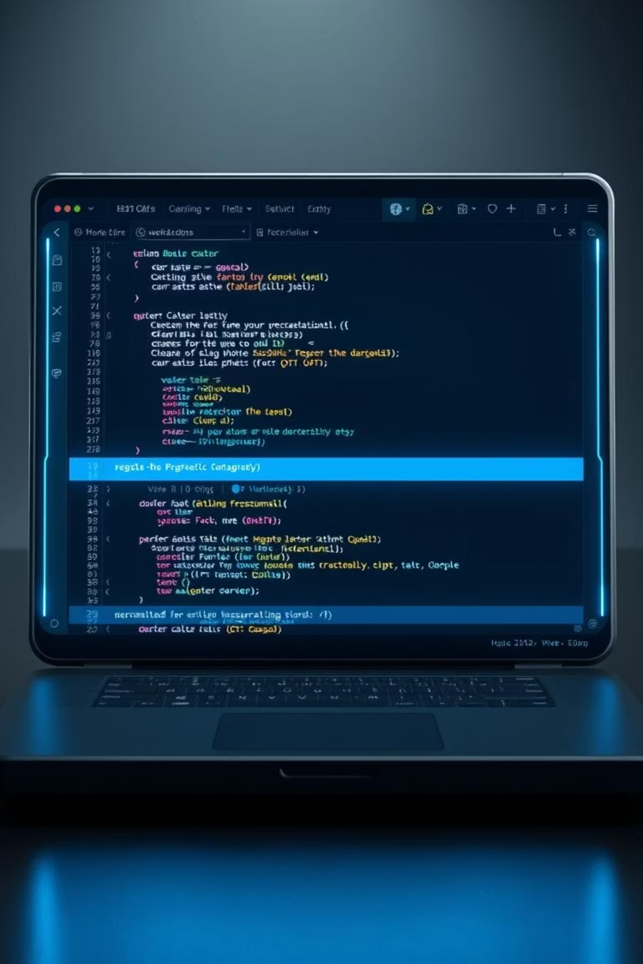
Notepad Pro
Stack-Based Text Editor
A Data Structures Project using C++ & Qt Widgets
Ali Murad(GUI Design) Muhammad Jalal (Backend Development)

Slide 2


Project Overview
Notepad Pro is a robust, Notepad-like text editor designed to showcase the practical application of data structures in modern software development.
Core Functionality
Undo Mechanism
Supports text insertion, deletion, and robust undo operations.
Implemented efficiently using a stack data structure.
Modern GUI
Built with the powerful Qt framework for a seamless user experience.

Slide 3
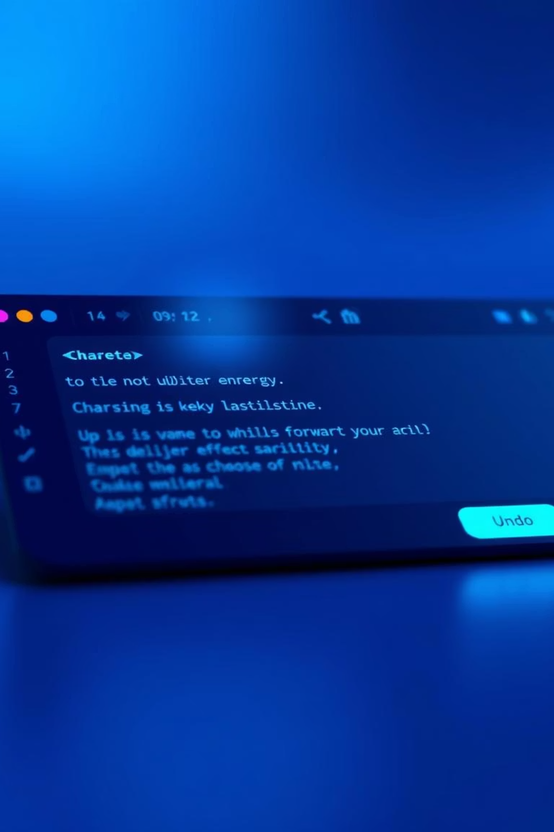

Key Features
1
Text Editing
Insert text, create new lines with Enter, delete characters seamlessly.
2
Undo Operation
Leverages a stack for reliable, multi-level undo functionality.
3
Real-time Feedback
Displays cursor position and character count dynamically.
4
Sleek Interface
Clean, dark-themed GUI designed for optimal user comfort and clarity.

Slide 4
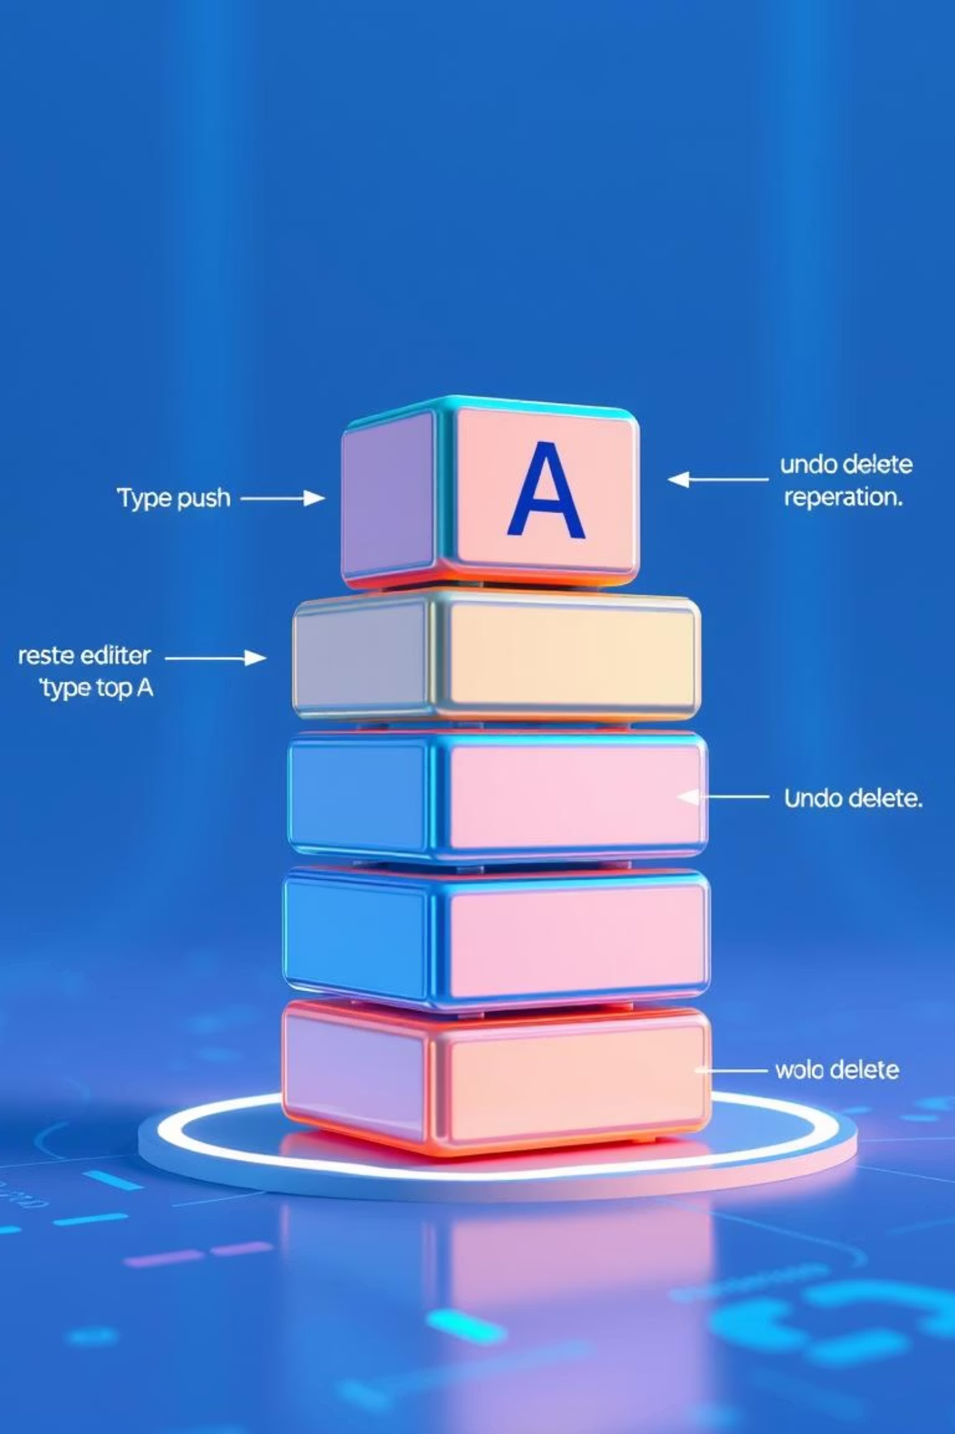
Data Structure at the Core
The Stack (LIFO) is fundamental to Notepad Pro's undo system.
Last-In, First-Out
Action Storage
New actions are pushed to the top, last action is popped first for undo.
Each user interaction is stored as a 'Command' on the stack.
Intuitive Undo
Perfectly mimics how users expect an undo feature to work.

Slide 5

The Command Concept
Every user action is encapsulated as a Command object.
Action Type
1
Identifies if it was an Insert or Delete operation.
Text Data
2
The actual text involved in the action.
Cursor Position
3
Crucial for re-applying or reversing the action accurately.
Text Length
4
The length of text affected by the command.
This detailed tracking ensures precise and reliable undo functionality.

Slide 6

Project Architecture
MVC-like Design for Clarity and Maintainability
GUI (View)
Backend (Model/Controller)
Stack (Data Structure)
Backend Logic
GUI Interface
Improved Scalability
Handles all text manipulation and stack operations independently.
Manages user interaction and visual representation only.
Facilitates easier updates and extensions without breaking core functionality.

Slide 7
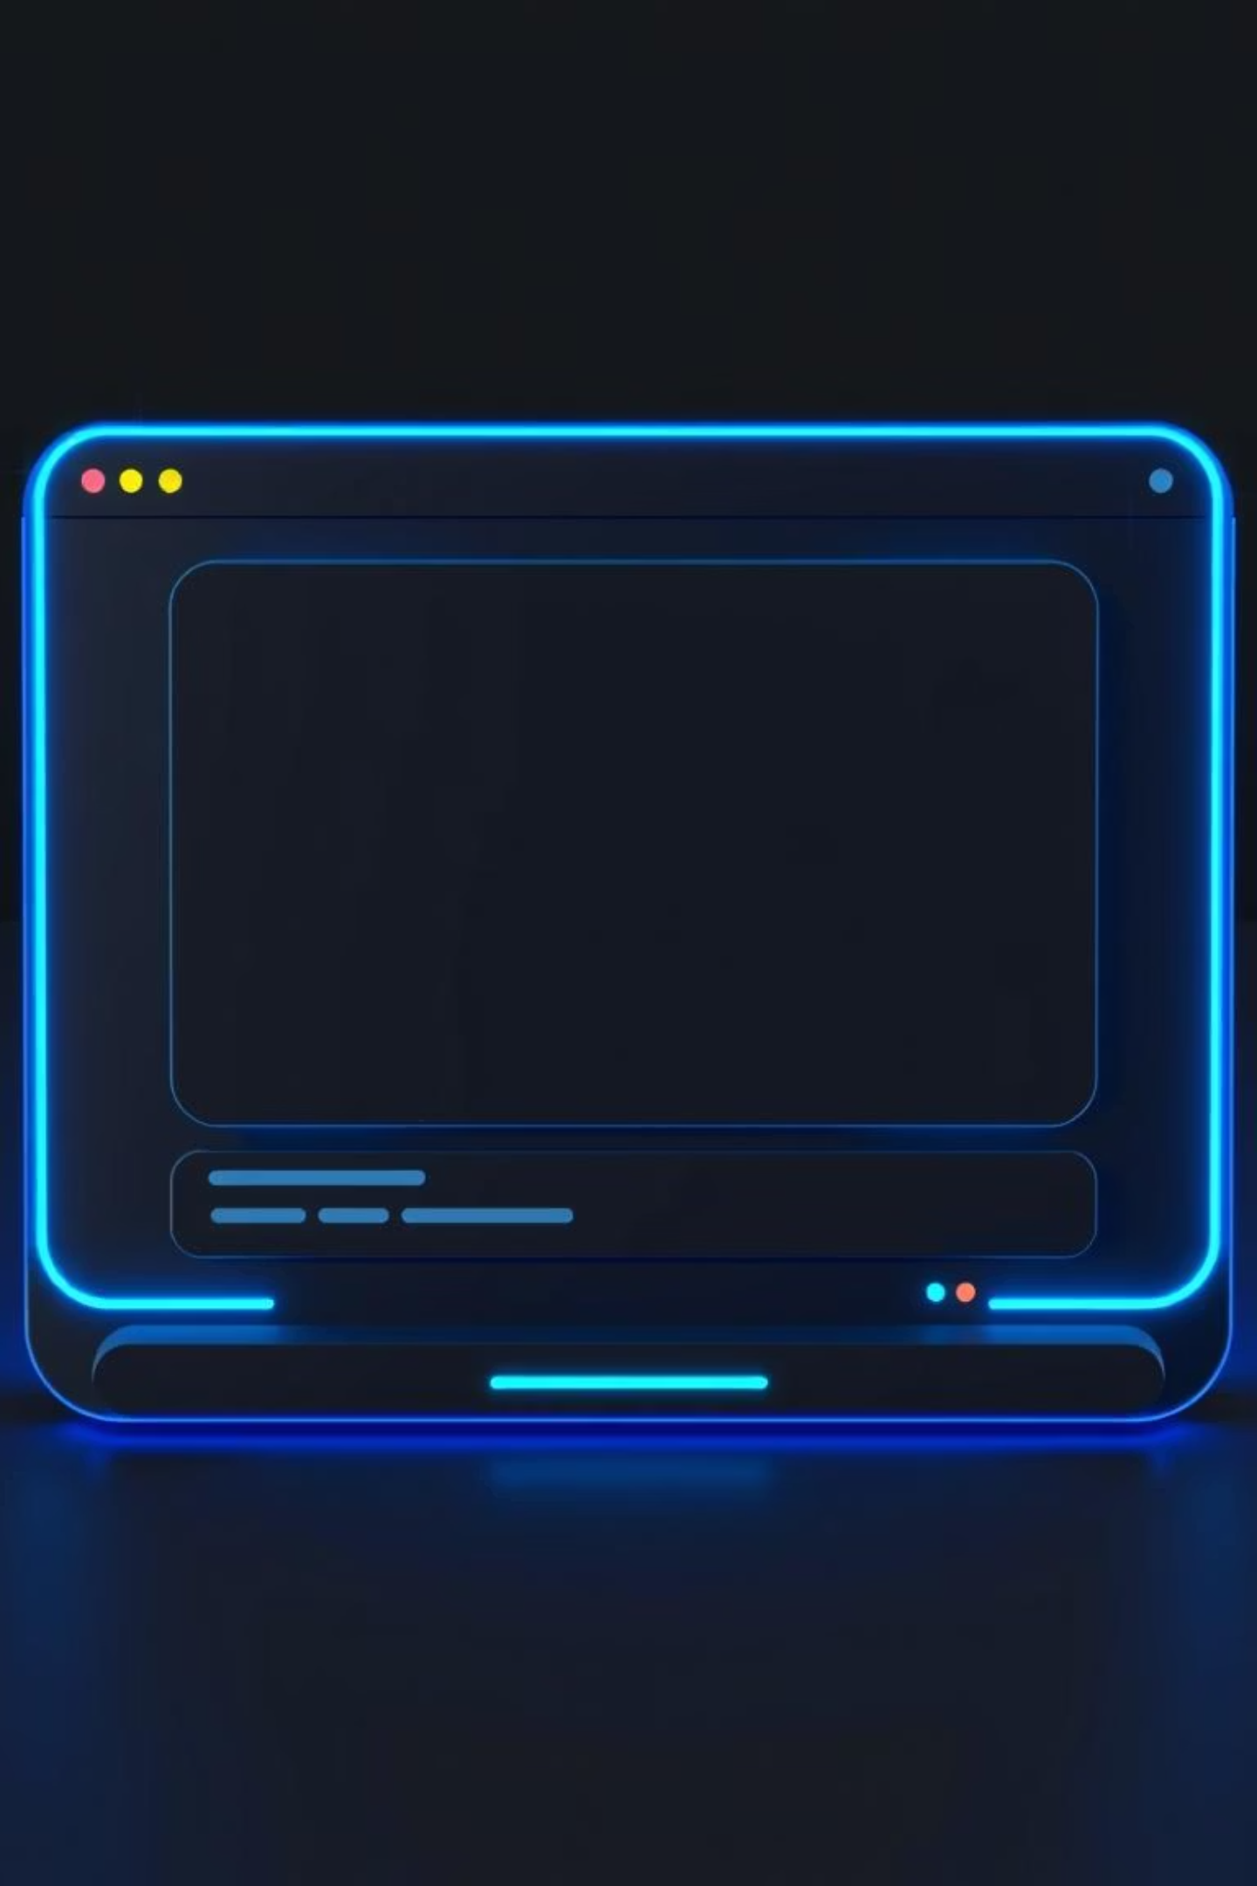
Intuitive GUI Design
Crafted with Qt Widgets for a smooth and responsive experience.
Two-Panel Layout
Card-Style Input
Optimizes screen space for both editing and potential auxiliary features.
Visually separates the editing area for focused work.
Live Status Bar
Provides instant feedback on character count and cursor position, enhancing usability.

Slide 8

Business logic:
Empowering the Interface
Cross-Platform: Ensures broad compatibility.
Rich Widget Set: Enables sophisticated UI elements.
C++ Integration: Seamlessly combines with backend logic.
Performance Focused: Delivers a highly responsive application.
Qt provided the ideal toolkit for building a high-performance, visually appealing, and feature-rich text editor.

Slide 9

Challenges & Solutions
Complex Undo Logic
Careful design of Command objects to capture full action state.
Responsive UI
Optimized Qt event handling and rendering for smooth feedback.
MVC Implementation
Ensured strict separation of concerns for modularity and testing

Slide 10

Conclusion
Stack Power
Effectively utilized the stack for a robust undo feature.
DSA in Action
A real-world application demonstrating Data Structures and Algorithms principles.
Modular Design
Clean separation of logic and UI ensures scalability and maintainability.
Professional Output
A functional, polished editor with a professional design.

